Slide 1
smroW
Alex ogillbee
Joseph Hill
Fernando Trevino

Slide 2
Game explanation
2D turn-based tactical shooter, inspired by Worms
Tile-based map
Each tile has its own health, not always destroyed on impact
Each map has different environment behavior
Special weapons

Slide 3
Game Decisions
Unity
Best 2D game engine
Prior experience
Why inspired by worms?
Popular game style
Turn-based system allows multiplayers with one computer

Slide 4
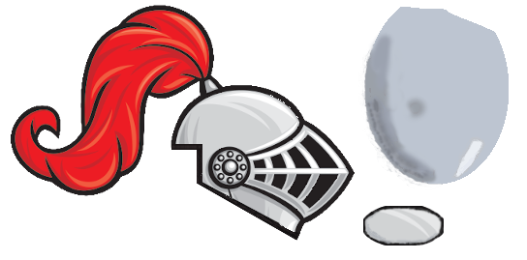
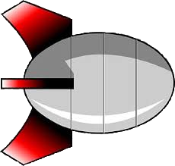
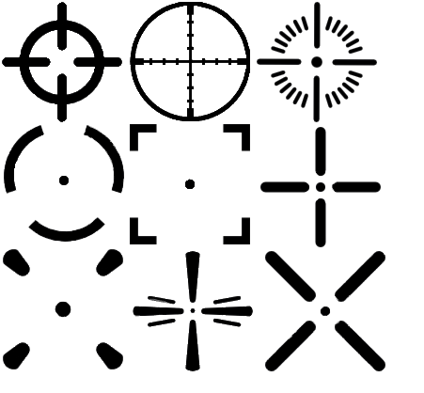


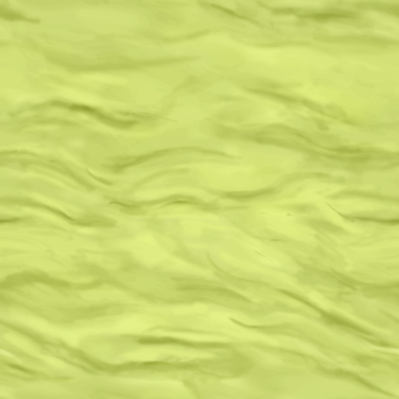


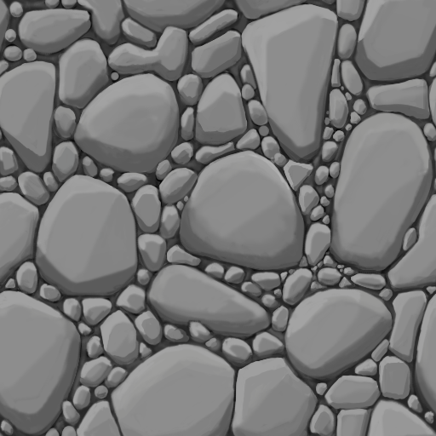

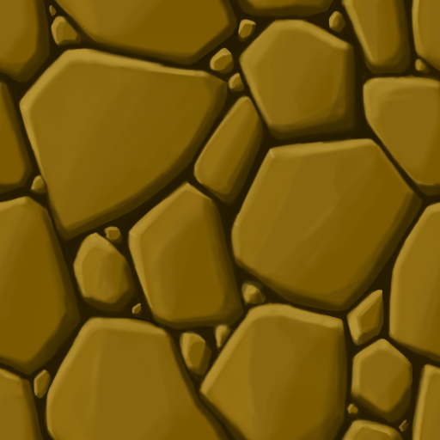
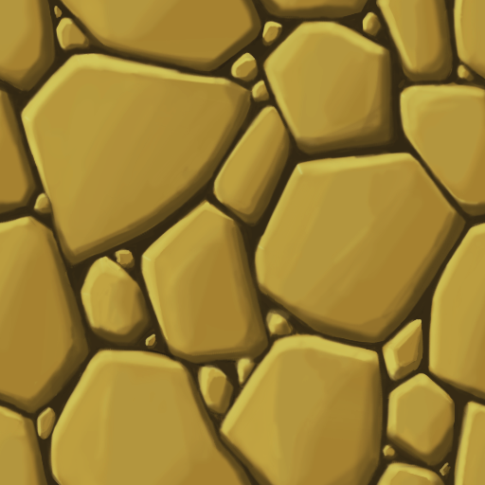
Art

Slide 5
Audio

Slide 6
Task Breakdown
Alex
AI, Menu
Fernando
Weapon Interactivity and Scripts, Gameplay
Joseph
Map Creation, Environment Interaction

Slide 7
Schedule
Create some weapons, characters, map
Write game logic for player interaction with weapons
Create menu to control game settings
After game is playable with less features, add:
Basic AI
Destroyable, dynamically generated map/environment
Weapon/Tool Drops
Implement environment interaction
Add more weapons, players, more complex AI

Slide 8
First Playable
One complete map, with audio
Basic menu (enough to set up a game)
Game flow
Can go through a full game
One weapon of each type, with audio
Gun, launcher, close range

Slide 9

Questions?

